Slide 1


Classification Model Truist
Team Nimble Niners

Slide 2




MEET THE TEAM
KAJARI
BHAUMIK
MANASI
SURYAVANSHI
ROHIT
REDDY AMBATI
HIRANYA
VAISHNAVI BANDI
LinkedIn
LinkedIn
LinkedIn
LinkedIn

Slide 3
AGENDA
PROBLEM STATEMENT
FEATURE EXPLORATION
MODEL OPTIMIZATION
1
2
3
4
5
6
EXPLORATORY DATA ANALYSIS
MODEL SELECTION
CONCLUSION

Slide 4
PROBLEM STATEMENT
1
2
3
Machine Learning model that can help predict CD enrollments
To Explore the effect of various factors(independent variables) on CD enrollment(target)
To understand generational financial trends better and optimize our marketing efforts

Slide 5
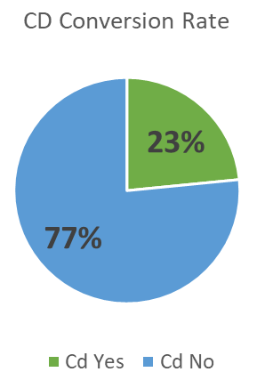
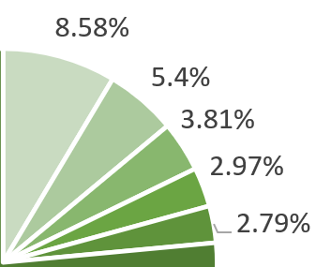
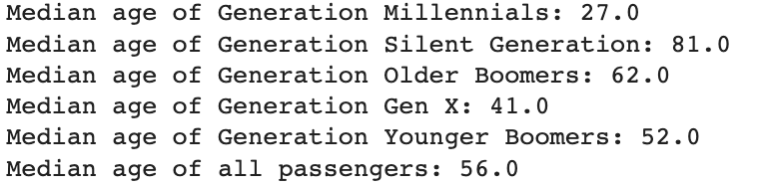
EXECUTIVE SUMMARY
84%
Silent Generation
Millennials
Accuracy in %
Generation X
Younger Boomer
73%
Older
Submission Number
With each subsequent trial, more accuracy was achieved

Slide 6
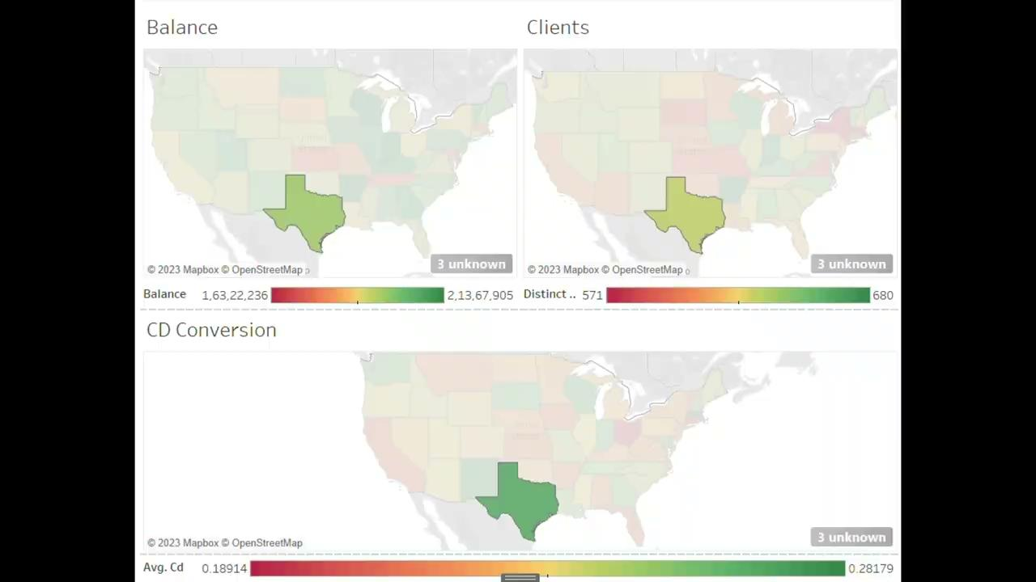
State Wise CD Distribution- A Heat Map
State | Total Balance | Clients | CD Conversion | Business Impact
SOUTH DAKOTA | 18350698 | 589 | 25.976% | Good
TEXAS | 19605476 | 635 | 26.814% | Target
ARKANSAS | 21262830 | 675 | 21.926% | Target
KANSAS | 17437589 | 596 | 21.644% | Ignore

Slide 7
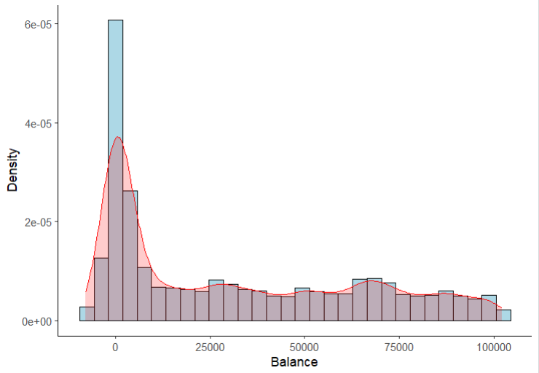
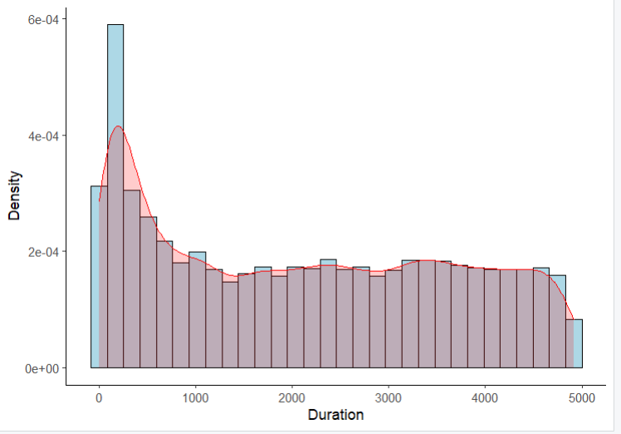
DATA PRE-PROCESSING
Data Description
There are 36,872 records with 19 features and 1 target variable
Out of 19 features, there are 7 numeric features, 11 categorical features
Numeric features:
Balance and Duration are heavily right-skewed
Categorical features:
Zip Code are not very useful in predicting CD enrolment
ZIP code | 180 | 94 | 45 | 20 | 11 | 1 | 1
Records | 1 | 2 | 3 | 4 | 5 | 6 | 7

Slide 8
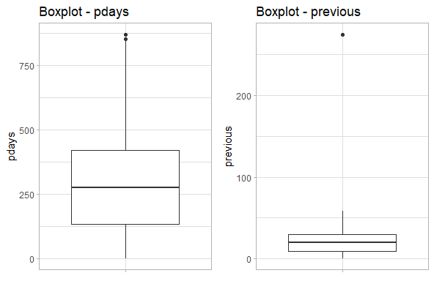
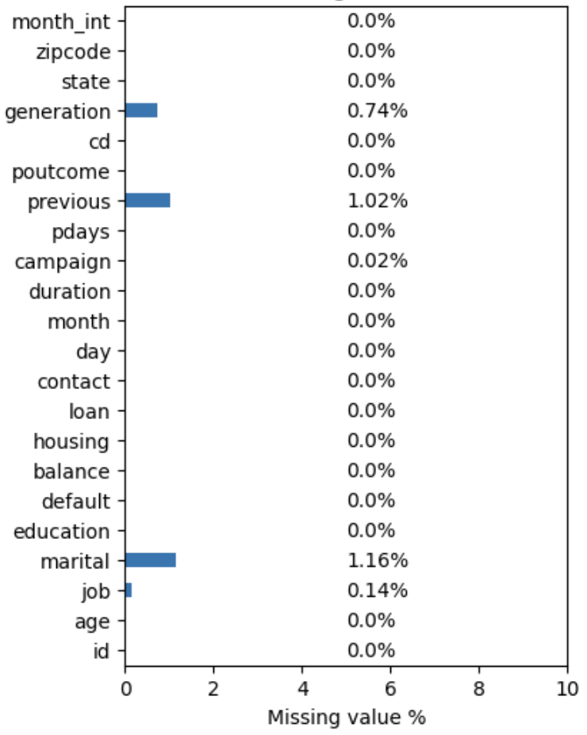
DATA PRE-PROCESSING
% Missing values in each categorical variable
Missing values in the data set were less than 2%.
Those were imputed
We used the median to impute numerical variables.
We imputed categorical variables using the mode.
Outliers in pdays and previous

Slide 9
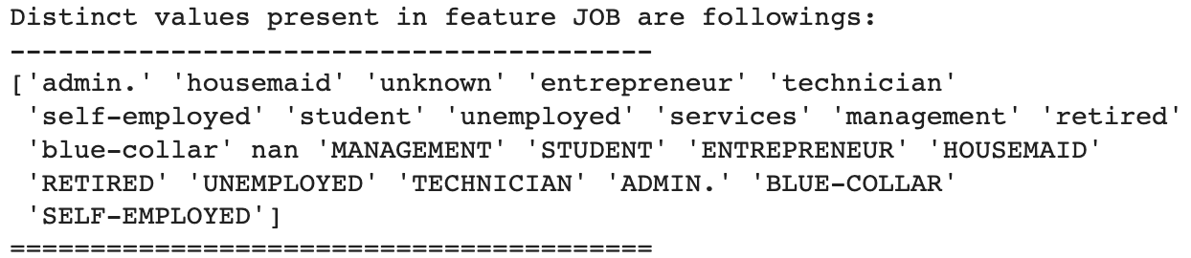
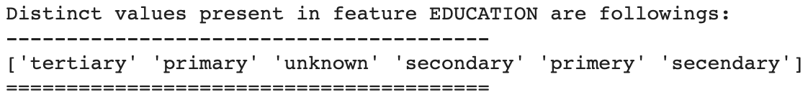
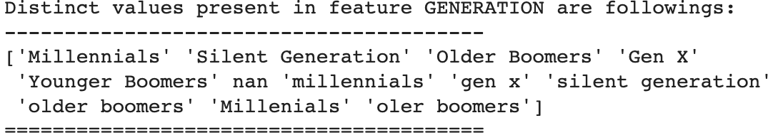
Data Cleaning
Spelling mistakes were corrected in all the Categorical variables

Slide 10
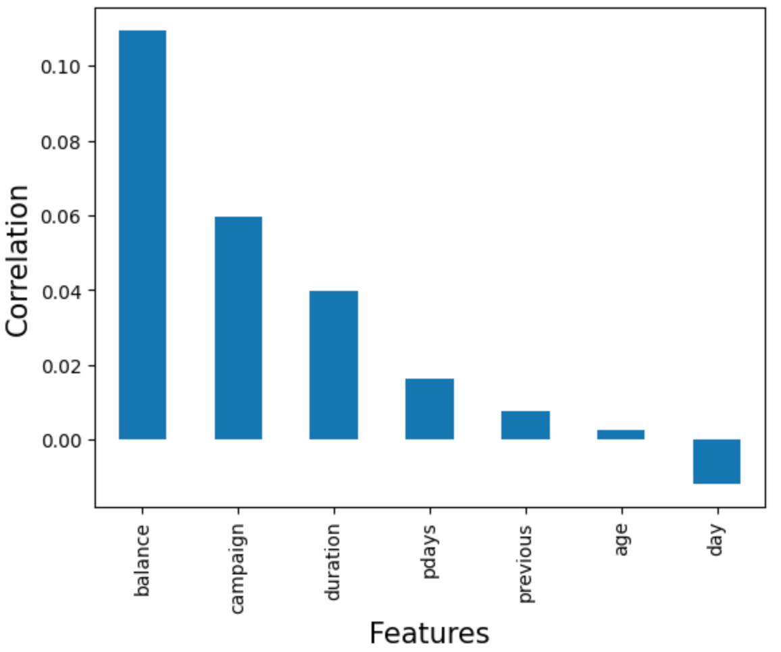
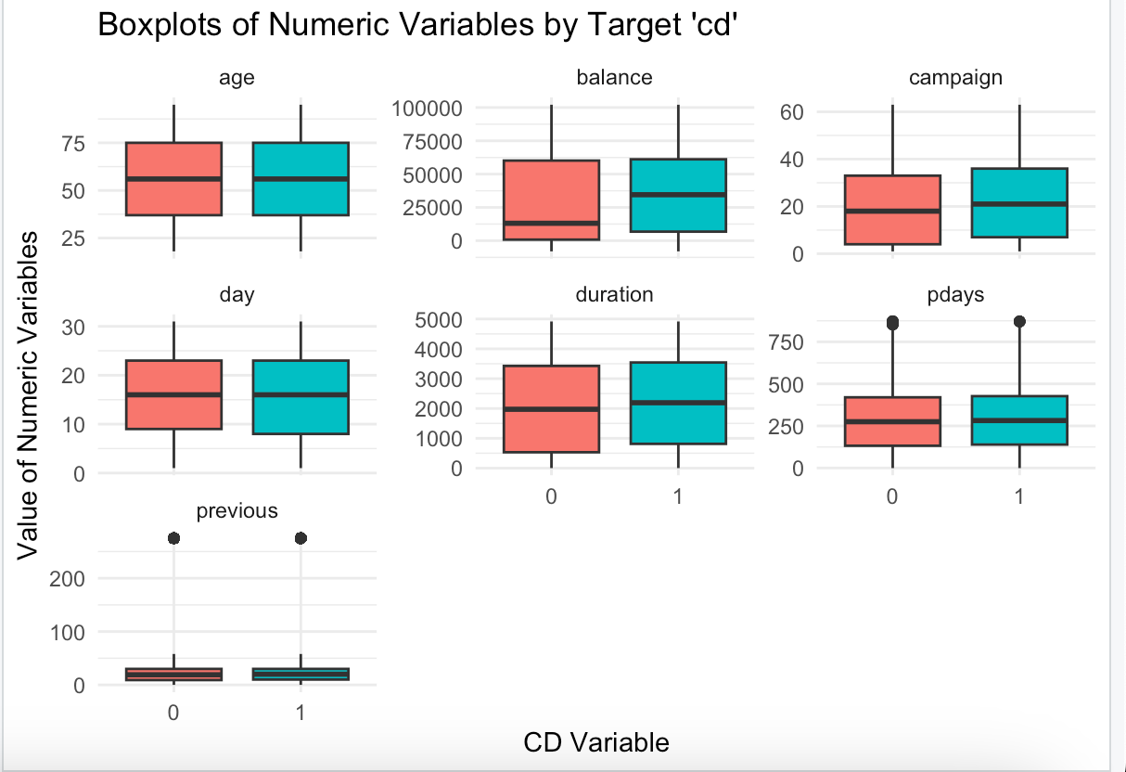
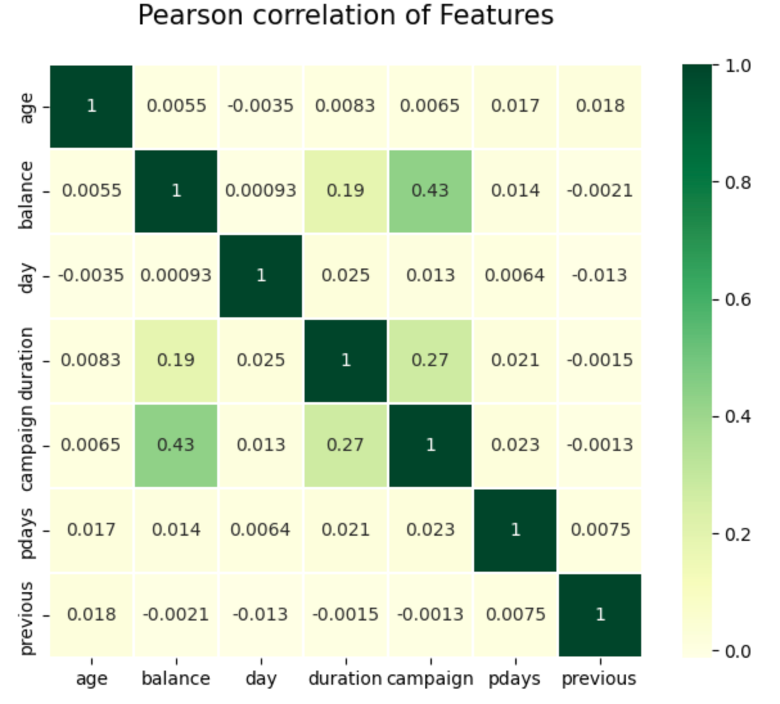
EDA- Numeric Features
EDA shows that Balance and Campaign have discriminative power for classification of CD

Slide 11
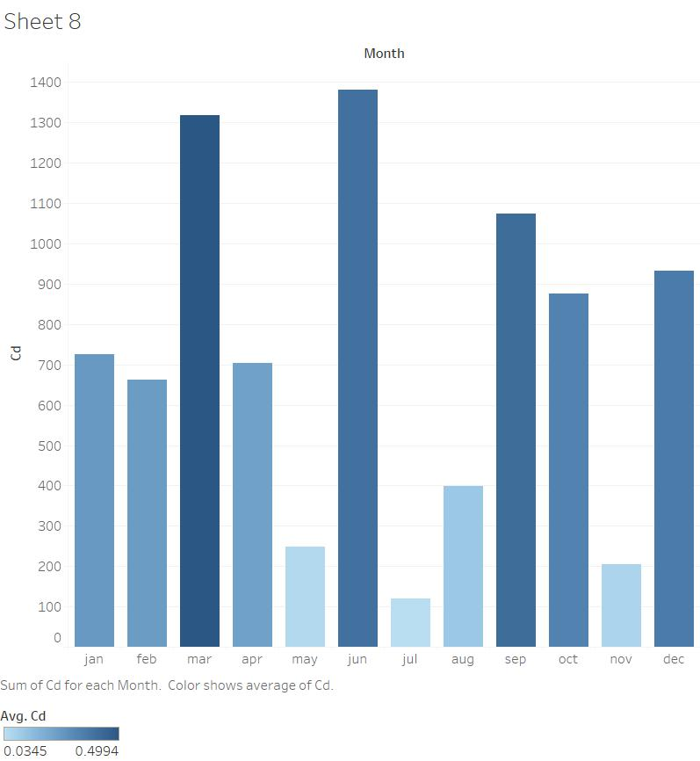
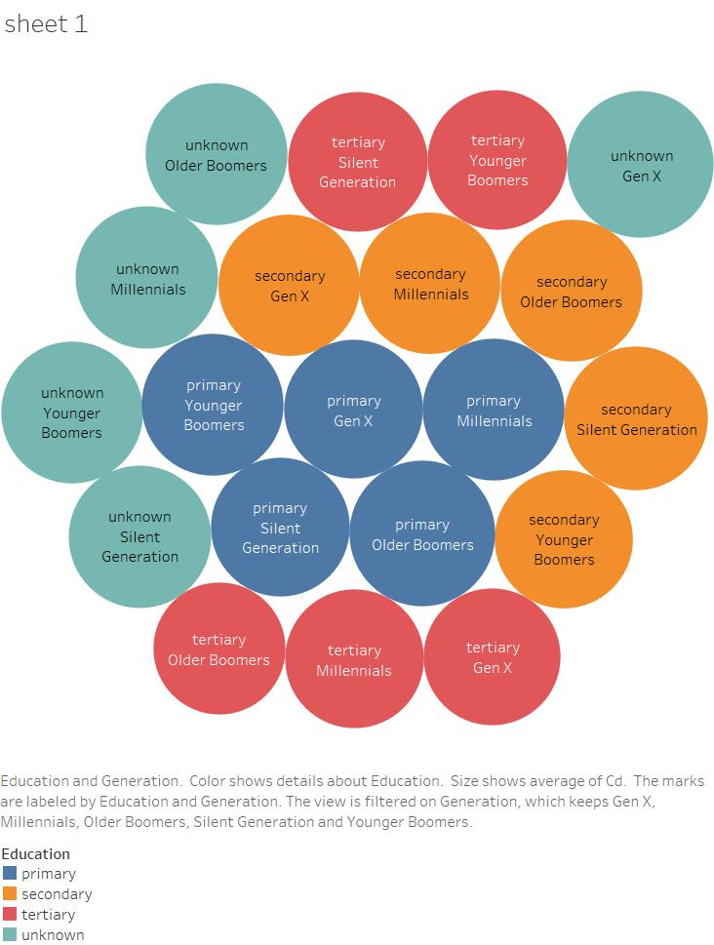
EDA - Categorical Features

Slide 12
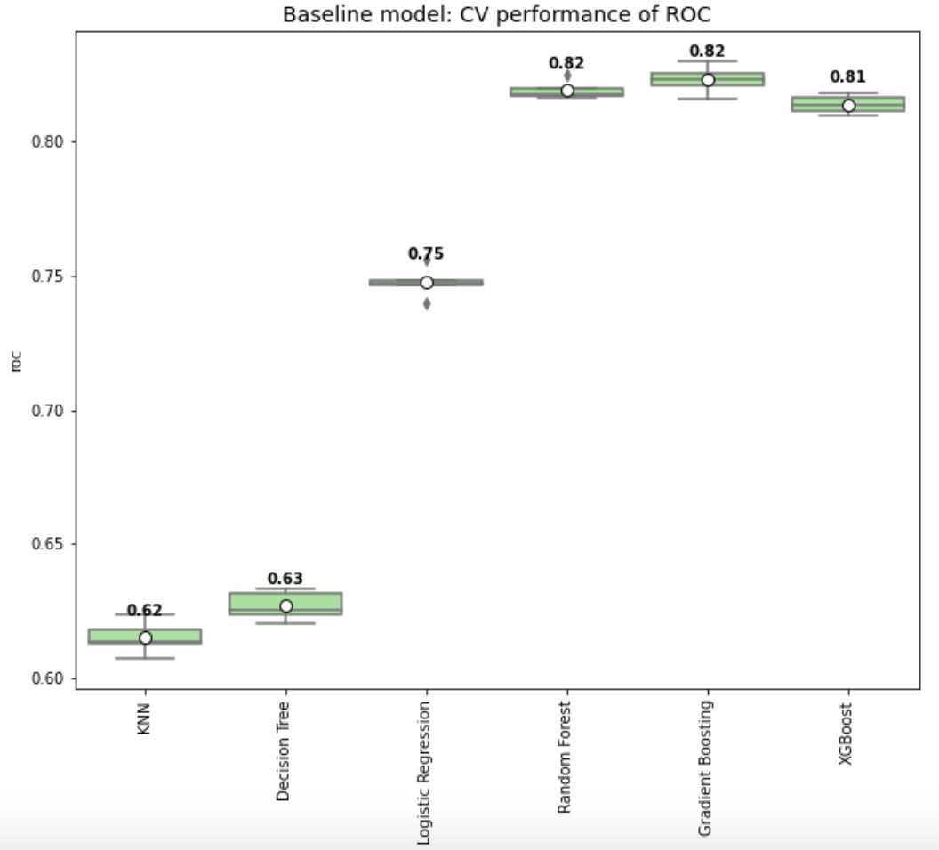
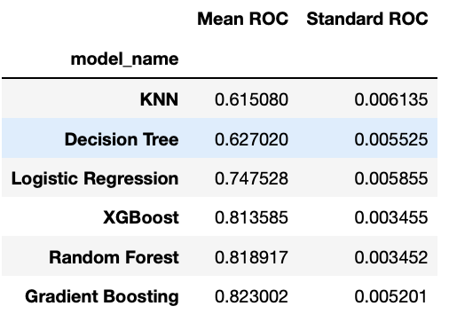
Baseline Model
Baseline models are built to kick-off the model development efforts
From 5-fold cross-validation results, Gradient Boosting performed the best

Slide 13
Recursive Feature Elimination
Train ML model
Obtain feature importance
Remove the least importance feature(s)
Retrain and Calculate ROC with remaining subset of features
Reached pre-defined Threshold?
NO
YES
Rank the features
Pre-defined Threshold can be minimum number of features required or some other criteria

Slide 14
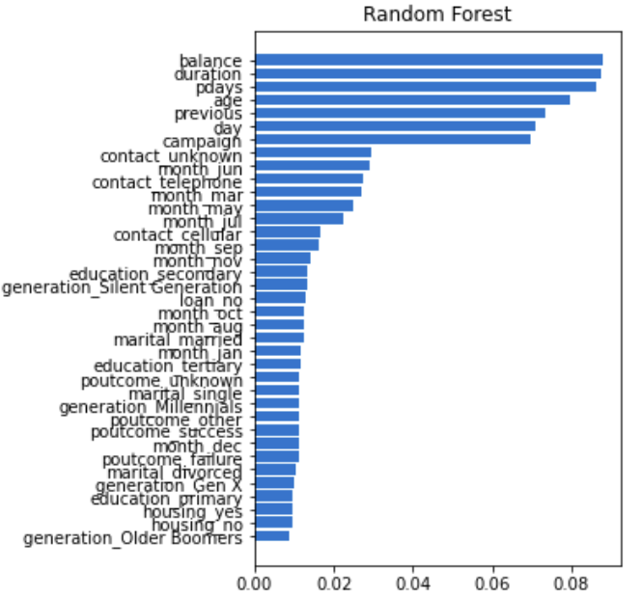
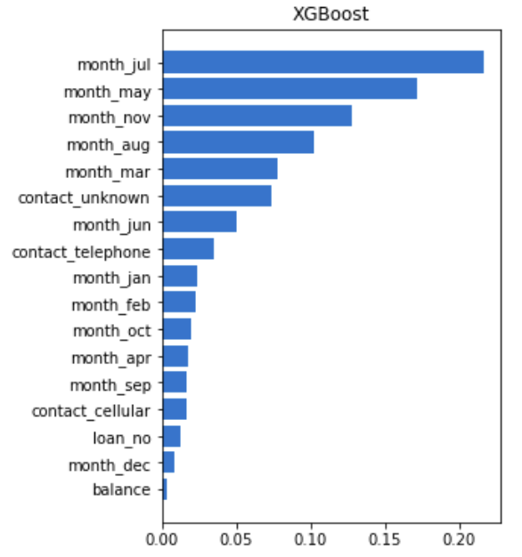
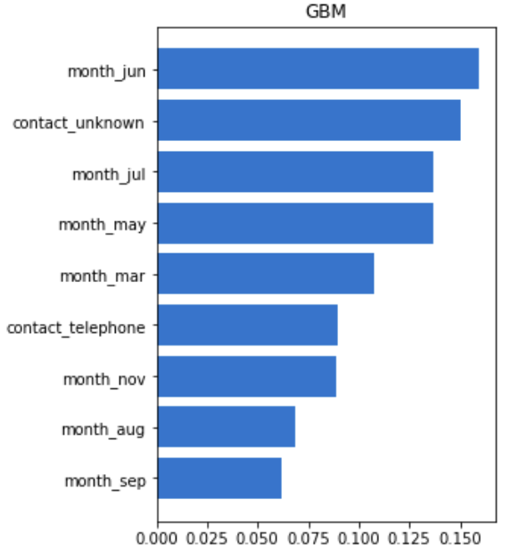
Feature Selection

Slide 15
Feature Selection
Underlying model: Random Forest, XGBoost, Gradient Boosting
Scoring criteria: ROC-AUC
Total features selected by each of the models are:
Final features selected for final model development are:
Numerical features: Balance, Campaign
Categorical features: Month, Contact, Loan
Model | Random Forest | XGBoost | GBM
# of features | 12 | 4 | 2

Slide 16
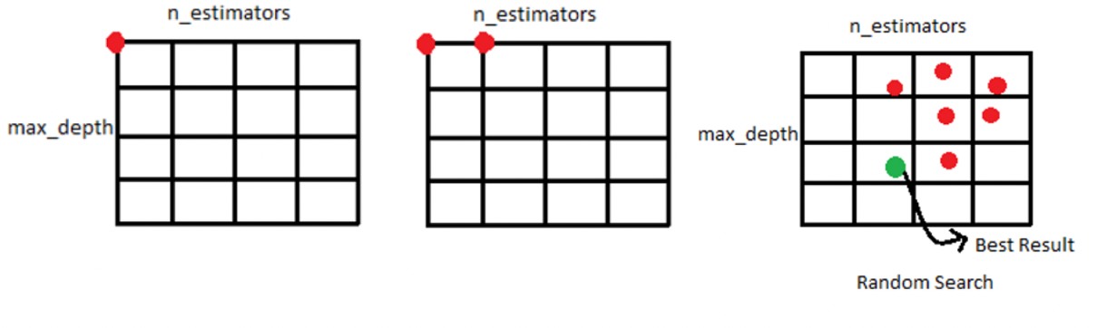
Grid Search

Slide 17
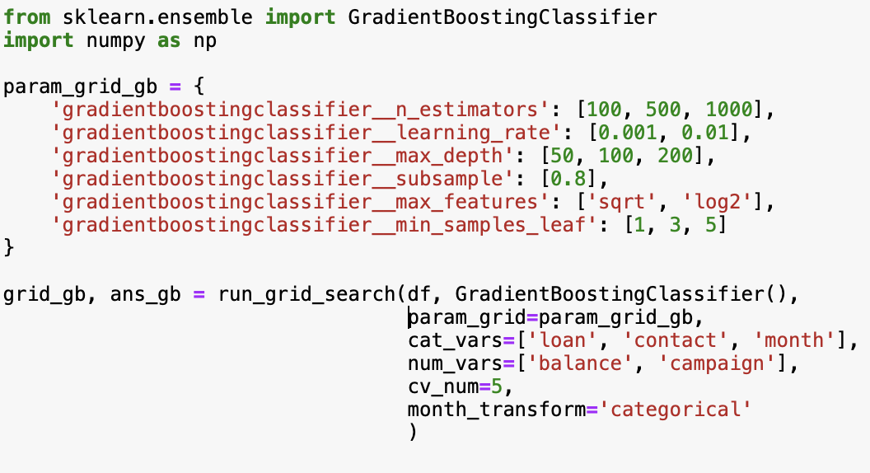
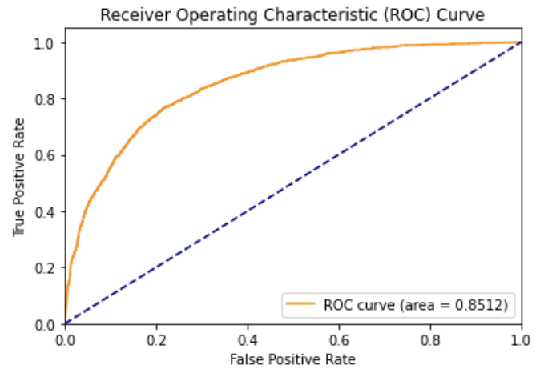
GridSearch: Gradient Boosting

Slide 18
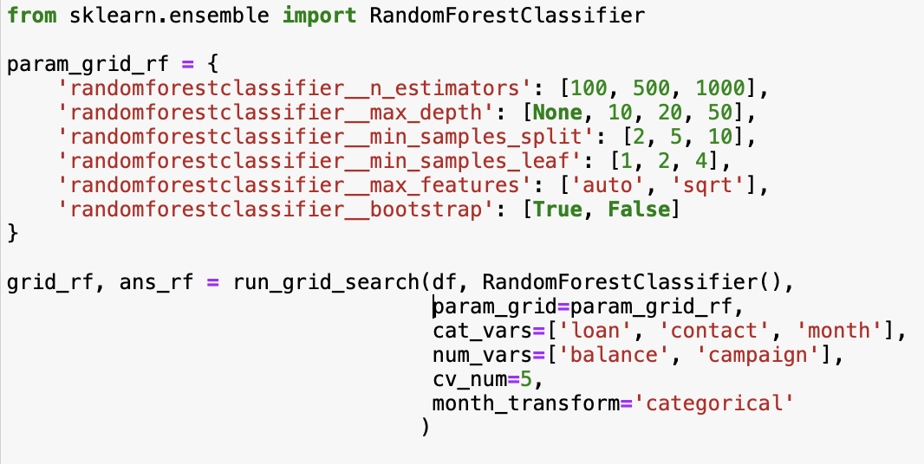
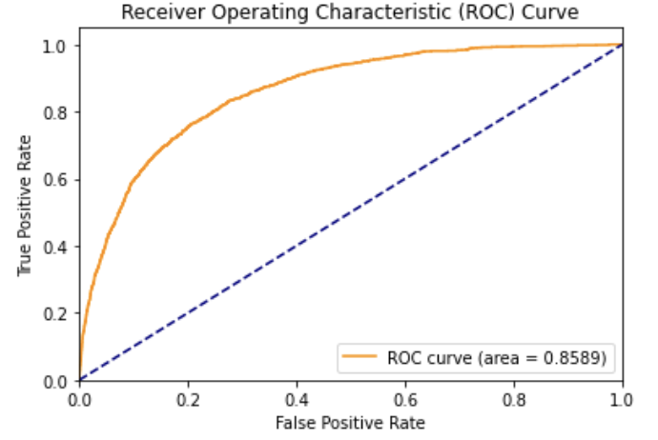
GridSearch: RandomForest

Slide 19
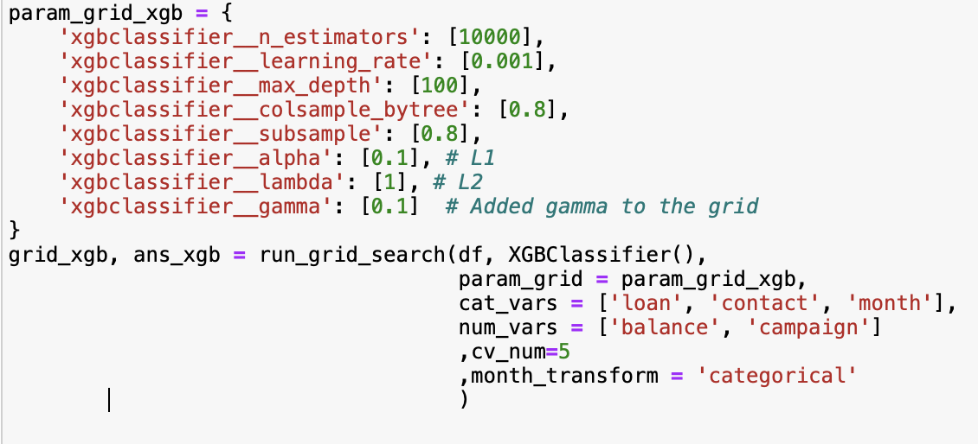
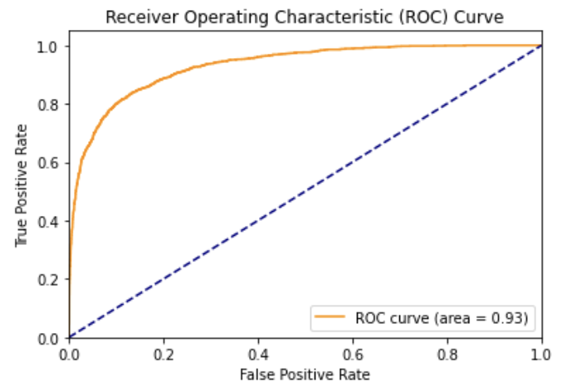
GridSearch: XGBoost

Slide 20
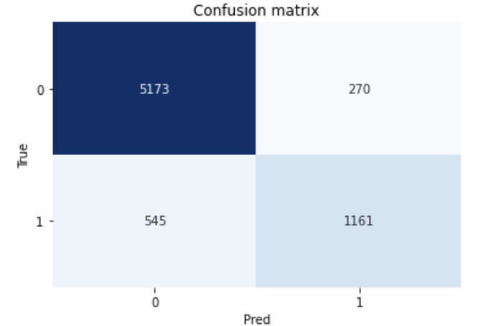
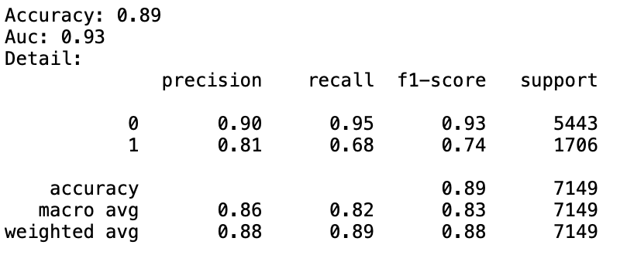
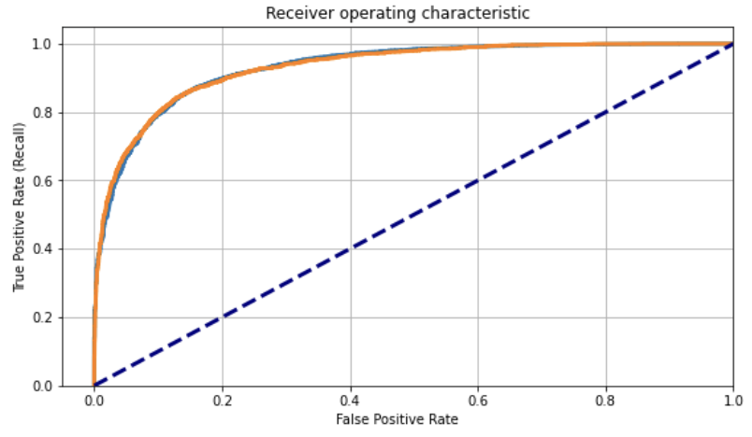
Model Evaluation

Slide 21
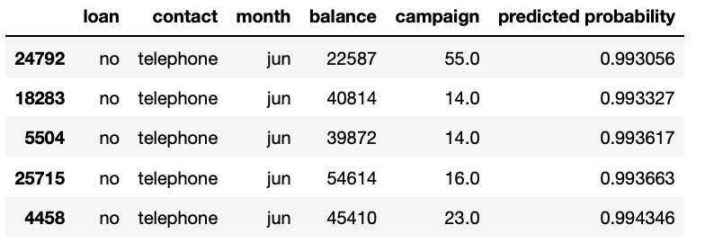
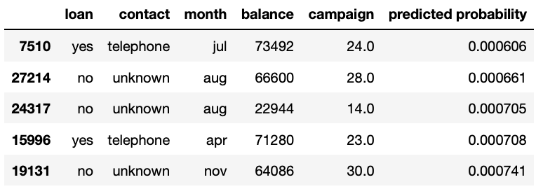
Model Inference
Top 5 - most probable records
All are from June (ending month of Q2)
No loans and High Balance
contacted through Telephone
Bottom 5 - least probable records
Contacted in middle of Quarter
High Balance but also Loan exists
contacted through other medium

Slide 22
Future Scope
Exploring ways(SMOTE) to treat the Imbalance Data set for more accuracy
Include external information such as macro economic drivers related to GDP, Unemployment and Interest Rates
Explore more advanced methodologies and ensemble of multiple models
Due to time constraints, we initially couldn't address data imbalance. But, we later balanced it with oversampling of the minority class and achieved 87% accuracy

Slide 23
Thanks!

Slide 24
Appendix
1.1. EDA- Numeric Variables: Density plots for each independent variable
1.2. EDA- Categorical Variables: Grouped Bar chart for each independent variable

Slide 25
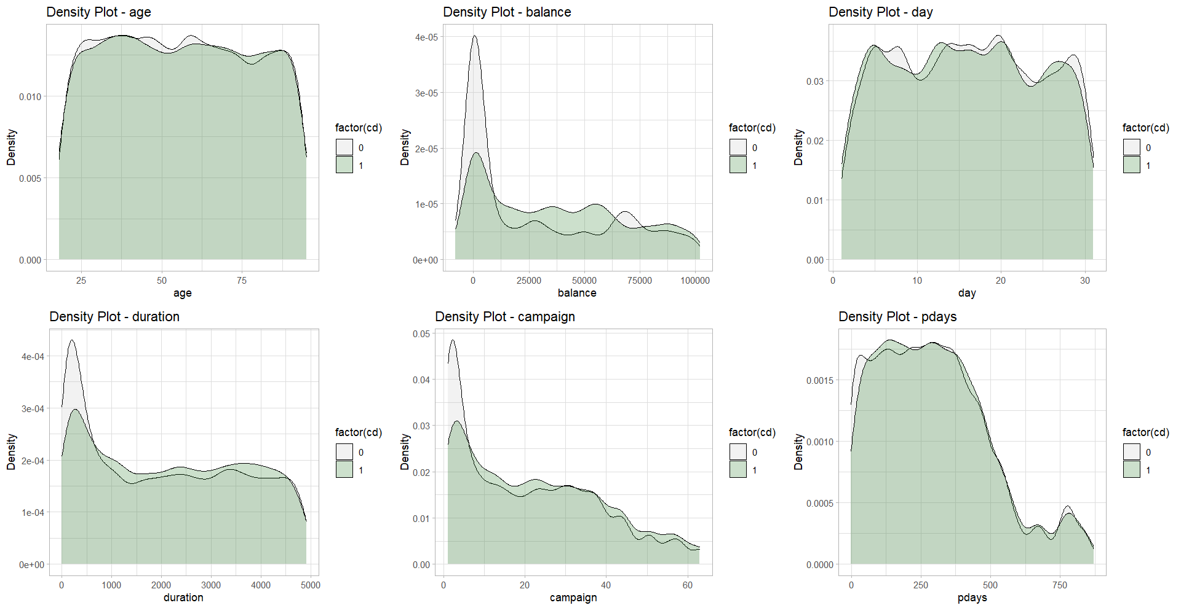
1.1. EDA-Numeric Variables

Slide 26
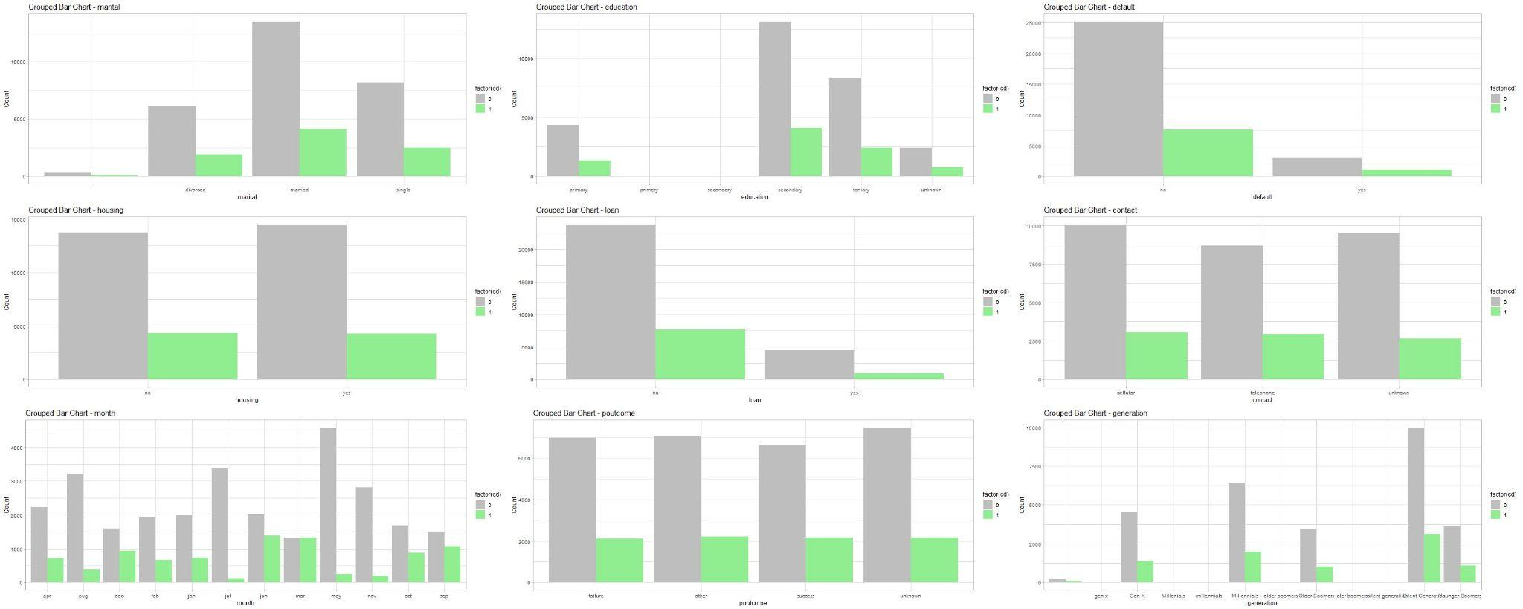
1.2. EDA- Categorical Variables

Slide 27
